Slide 1
Acquisitions infrastructure - Licenses and Amendments
Yoel Kortick
Senior Librarian

Slide 2

Agenda
Introduction
Roles for managing Licenses and Amendments
Adding a License
Adding an Amendment to a License
Associating a license to an electronic resource
Displaying the license information in discovery

Slide 3
Introduction

Slide 4
Introduction
Many electronic resources require licenses from the vendors that provide the resources.
Alma enables the institution to enter license information for tracking and informational purposes.
It is possible to enter both license information and amendments.
A license is associated with an activated electronic resource in the local inventory on the Repository Search page, or on the PO Line Summary page of the purchasing workflow
Licenses are managed on the Licenses and Amendments page which is accessed at Acquisitions > Acquisitions Infrastructure > Licenses.

Slide 5
Introduction
The license is used for informational purposes only.
Alma's functionality does not change based on license information.
For example, Alma does not restrict access to resources if a license is not present or if it expires.

Slide 6
Introduction
For general information about licenses see also Managing Licenses and Amendments
In this presentation we will show how to add a license manually.
For information about adding a license from an ONIX-PL file, see Adding ONIX-PL-Formatted Licenses.
For information about adding a license from a template, see Loading a License from a Template.

Slide 7
Roles for managing Licenses and Amendments

Slide 8
Roles for managing Licenses and Amendments
To view licenses and license amendments, the staff user must have one of the following roles:
  License Manager
  License Viewer
  Selector
  Purchasing Operator
  Purchasing Manager
To manage licenses, license amendments, and create license templates the staff user must have the following role:
  License Manager

Slide 9


Roles for managing Licenses and Amendments

Slide 10
Adding a License

Slide 11
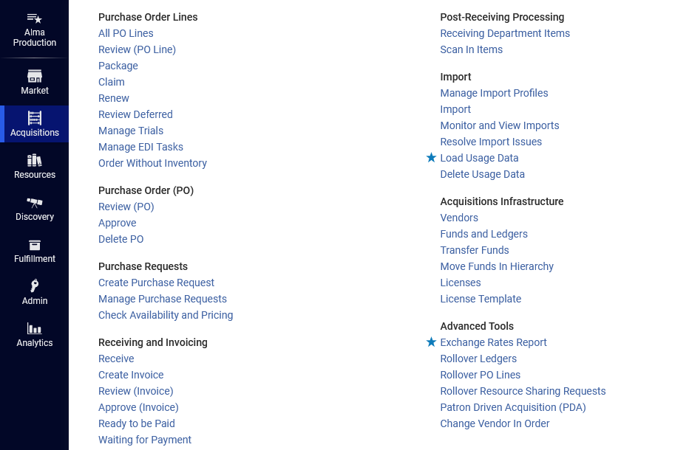
Adding a License
Access the Licenses and Amendments page at Acquisitions > Acquisitions Infrastructure > Licenses

Slide 12
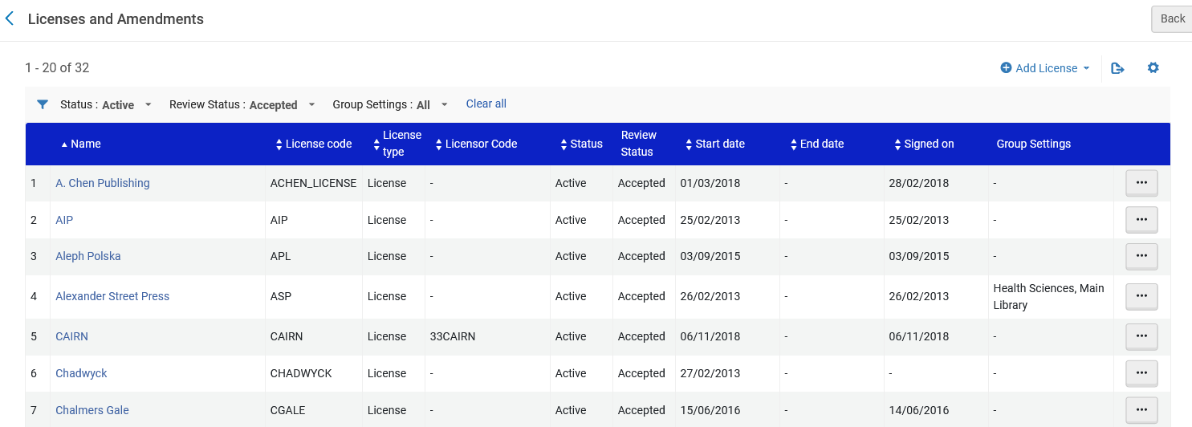
Adding a License
Filter the Licenses and Amendments page as desired

Slide 13
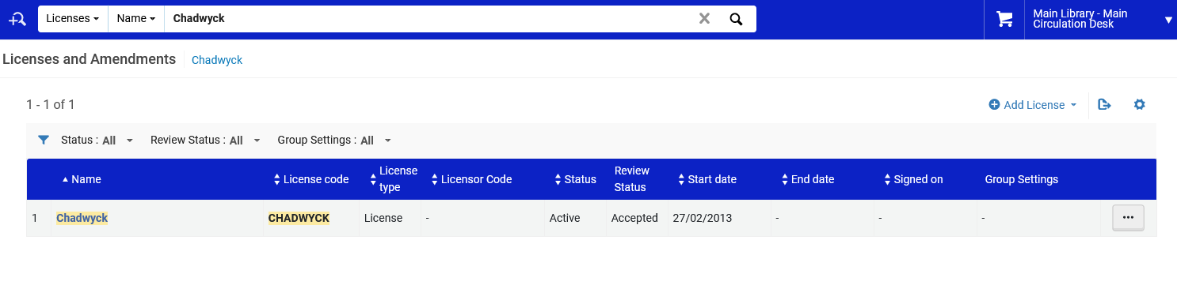
Adding a License
Note that it is also possible to access the “Licenses and Amendments” page by performing a search for licenses

Slide 14
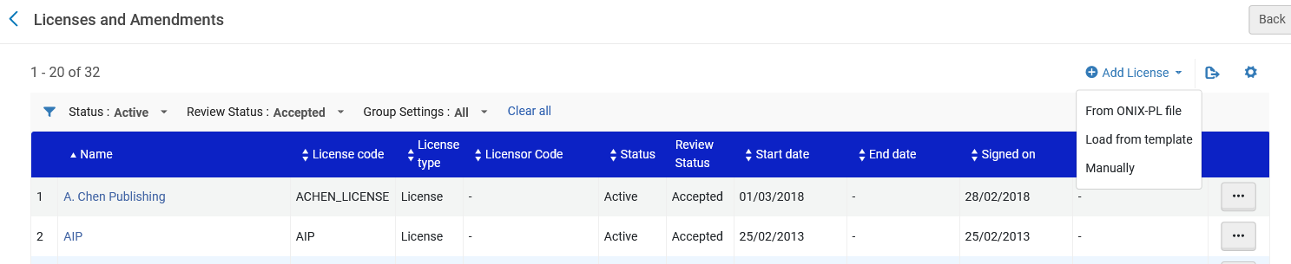
Adding a License
Select “Add License > Manually”

Slide 15
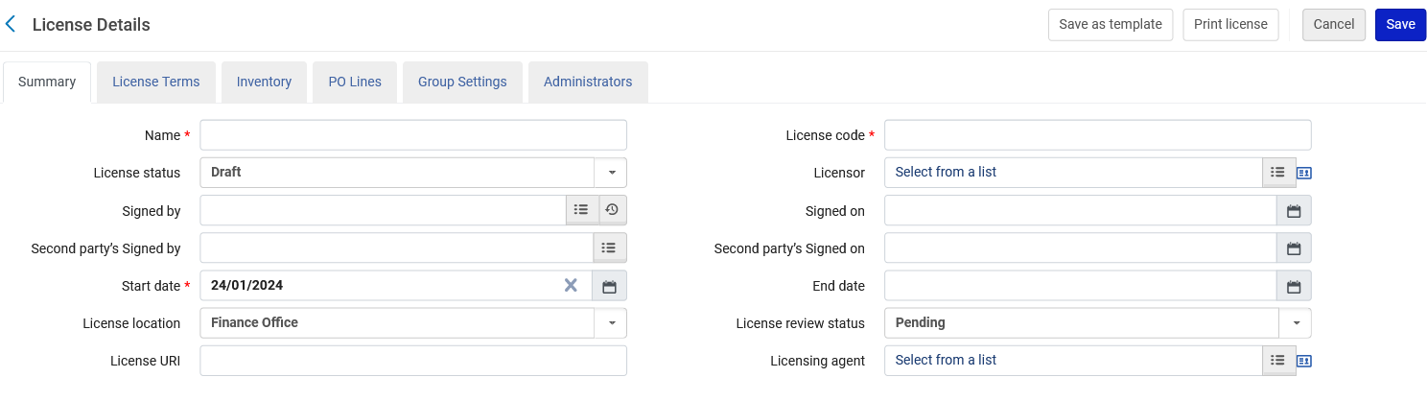
Adding a License
The Summary tab on the License Details page appears.

Slide 16
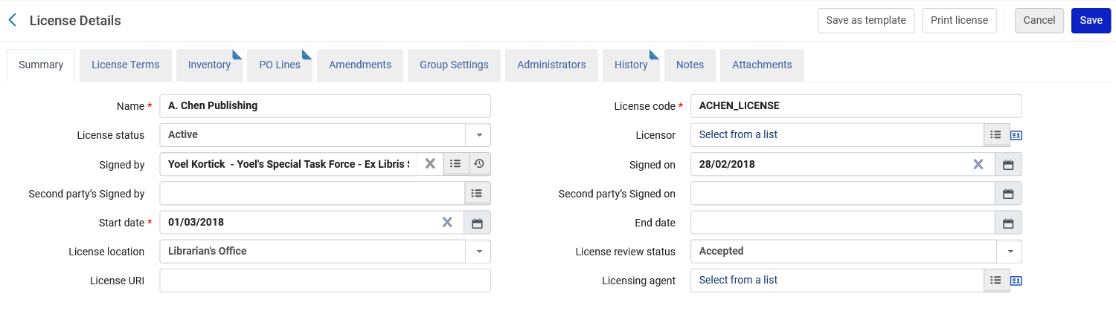
Adding a License
Enter the name of the license and license code. Select the start date of the license. These fields are mandatory.

Slide 17
Adding a License
A description of the fields on the Summary tab can be found in the “License Details (Additional Fields)” section of Adding a License
This will be an Active license.
Other options are:
Active – The license is activated and in use
Deleted –Deleted. Can be re-activated by selecting Edit in the row actions list and changing the license status value.
Draft – The license is created but not in use
Expired – "End date" is in the past (can be extended)
Retired – The license is no longer relevant

Slide 18
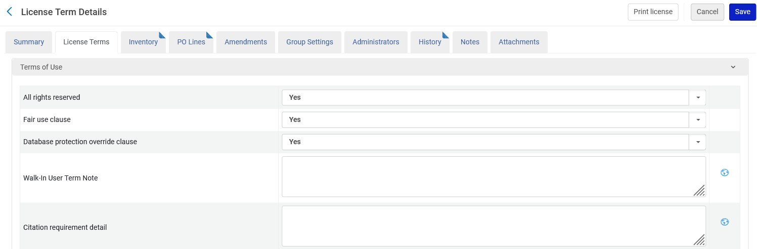
Adding a License
In the License Terms tab, configure the terms of the license, such as its terms of use, restrictions, and perpetual rights.
For information on these terms, see List of License Term Types
The sections and fields in this tab represent a subset of the full set.
An Acquisitions Administrator can configure which fields appear and in which order; for more information, see Configuring Sections Order and Managing License Terms.

Slide 19
Adding a License
We will now look at the “Inventory” tab.
When the license is first created the Inventory tab is empty.
The Inventory tab is populated only if the license is associated with an activated electronic resource.
For demonstrative purposes, the license has already been associated with four electronic collections and one portfolio

Slide 20
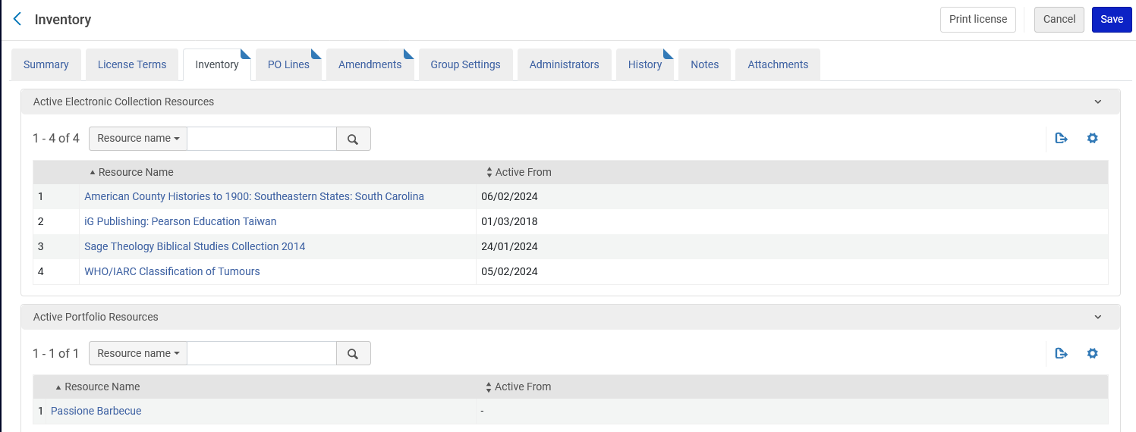
Adding a License
The staff user can access the Electronic Collection Editor and Electronic Portfolio Editor by selecting the links to the electronic collection or portfolio.

Slide 21
Adding an Amendment to a License

Slide 22
Adding an Amendment to a License
It is possible to create amendments to existing licenses.
Amendments modify the properties of the base license.
Amendments added to a license override the base license.
If an amendment is created, the license code must be modified (this is because the license code is unique to each license/amendment).

Slide 23
Adding an Amendment to a License
To add an amendment to a license:
On the Licenses and Amendments page select Create Amendment in the row actions list for the license you want to amend. The Summary tab on the License Details page appears.
Enter a name and a unique license code for the amended license.
Edit the remaining fields in this tab as required. For more information on these fields, see Adding a License.
In the License Terms tab, modify the terms of the amended license, as required.

Slide 24
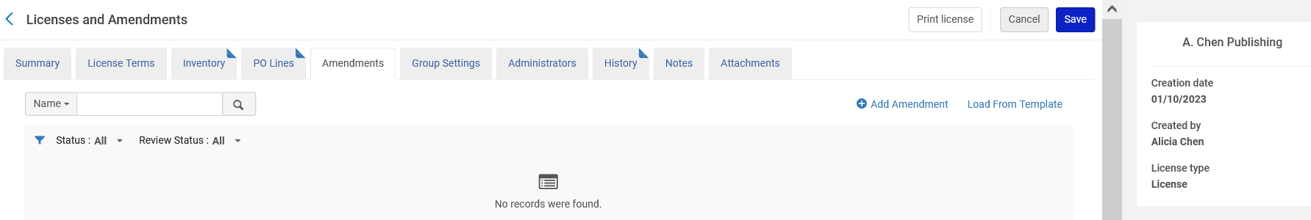
Adding an Amendment to a License
License “A. Chen Publishing” currently does not have an amendment

Slide 25
Adding an Amendment to a License
We can add an Amendment here

Slide 26
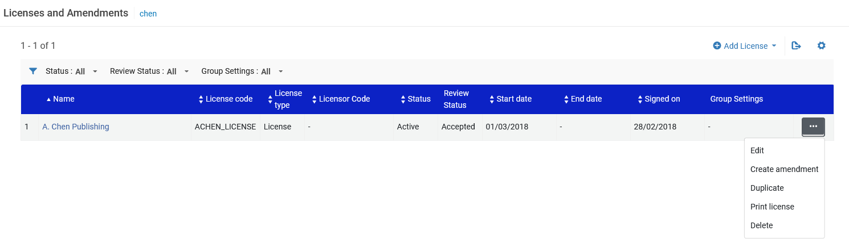
Adding an Amendment to a License
We can also add an Amendment here

Slide 27
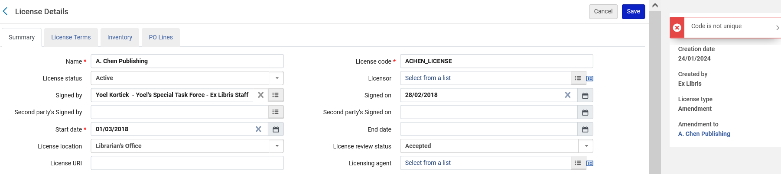
Adding an Amendment to a License
As stated, the code must be changed

Slide 28
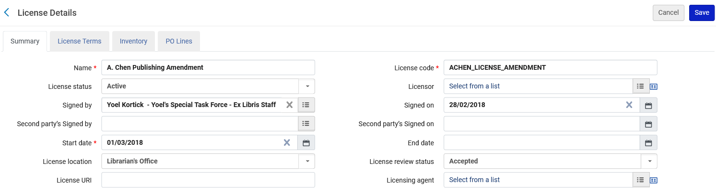
Adding an Amendment to a License
We changed the code from ACHEN_LICENSE to ACHEN_LICENSE_AMENDMENT.
We changed the name from “A. Chen Publishing” to “A. Chen Publishing Amendment”.

Slide 29
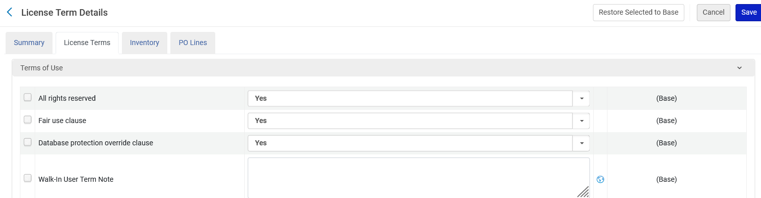
Adding an Amendment to a License
In the License Terms tab, we will modify the terms of the amendment as needed.
We will change the “Database protection override clause to “No”

Slide 30
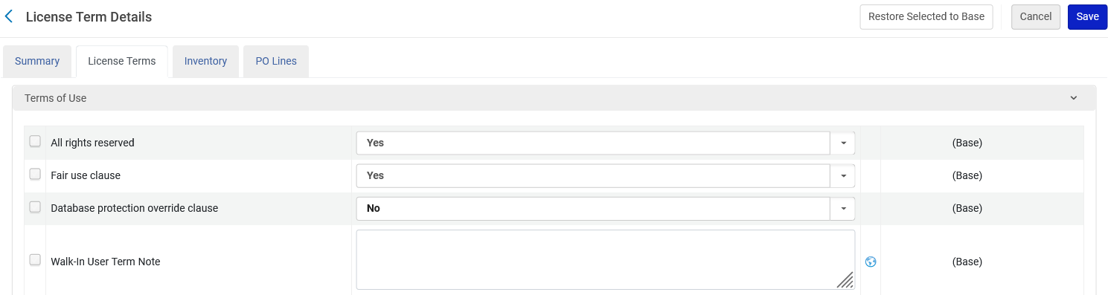
Adding an Amendment to a License
Here we have changed the “Database protection override clause” from “Yes” to “No”

Slide 31
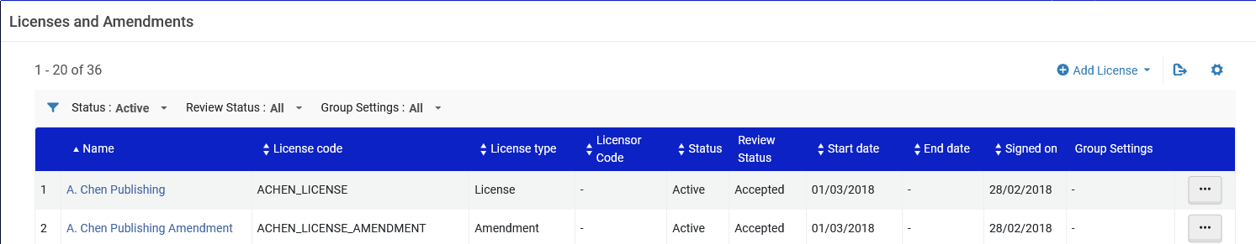
Adding an Amendment to a License
Now we have both a license and an amendment

Slide 32
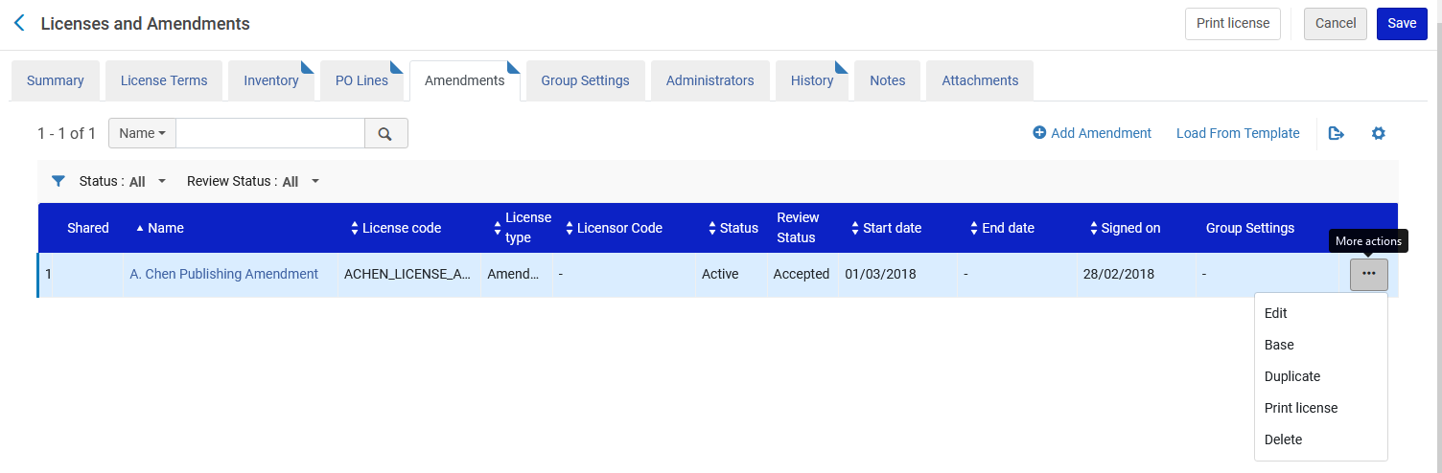
Adding an Amendment to a License
If we edit the license, we can see that it has an amendment, and we can edit the amendment

Slide 33
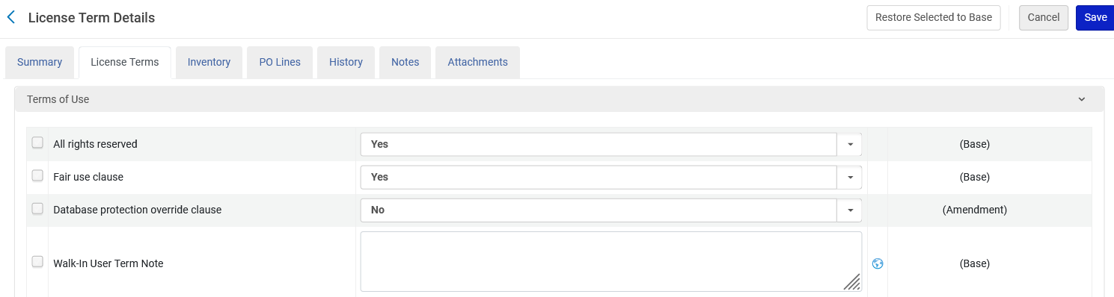
Adding an Amendment to a License
In the amendment “License Terms” tab we can see if the term is from the license (base) or from the amendment.

Slide 34
Associating a license to an electronic resource

Slide 35
Associating a license to an electronic resource
A license can be associated to an electronic resource
From within the electronic resource
In the POL of the electronic resource

Slide 36
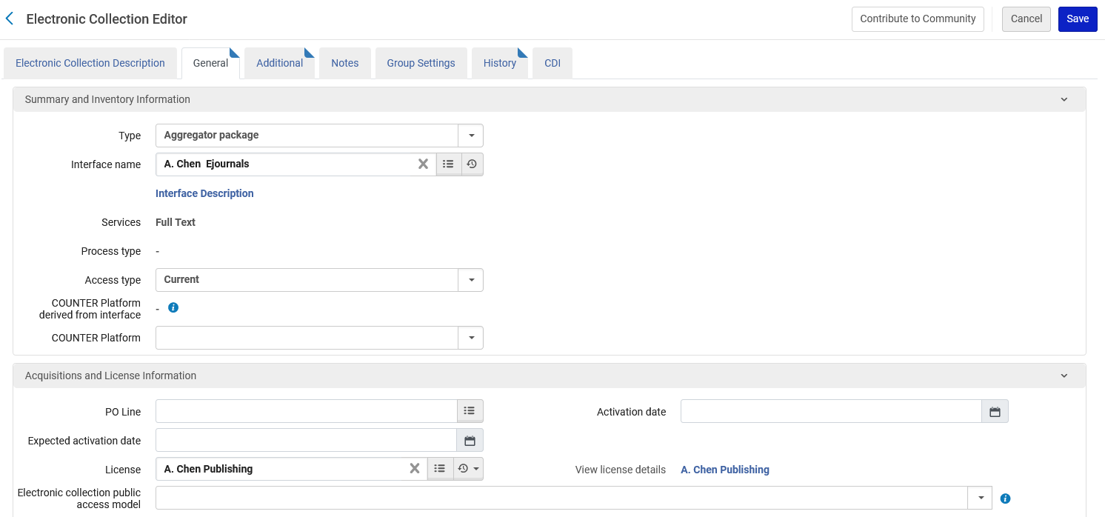
Associating a license to an electronic resource
In the electronic collection “Resources about libraries in Taiwan” we have associated the license “A. Chen Publishing” to the resource.

Slide 37
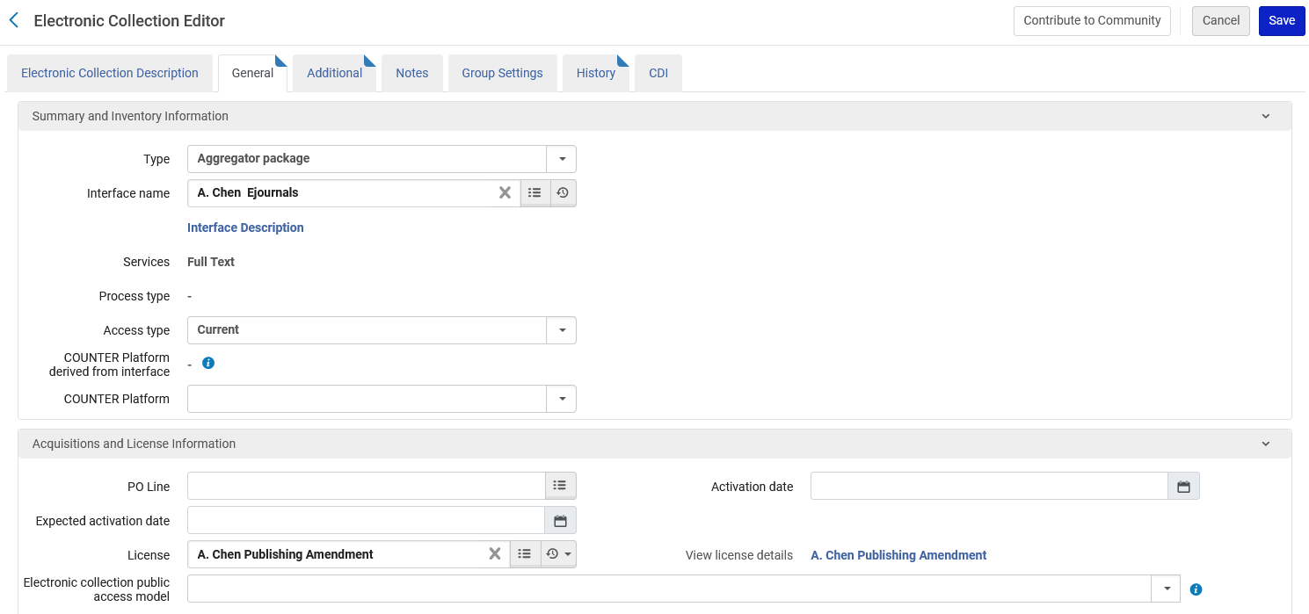
Associating a license to an electronic resource
We could have instead associated the license A. Chen Publishing Amendment” to the resource.

Slide 38
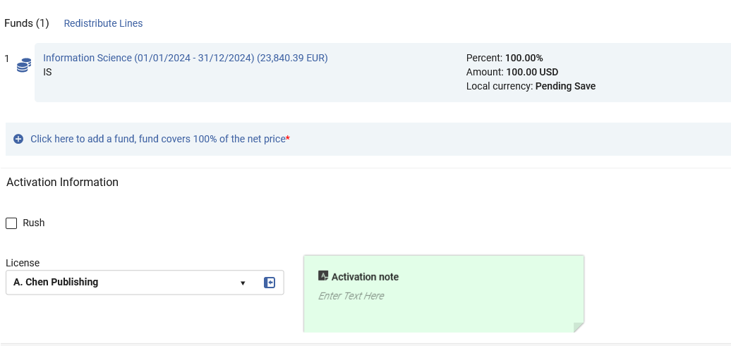
Associating a license to an electronic resource
We could have instead associated the license A. Chen Publishing” to a POL of an electronic resource.

Slide 39
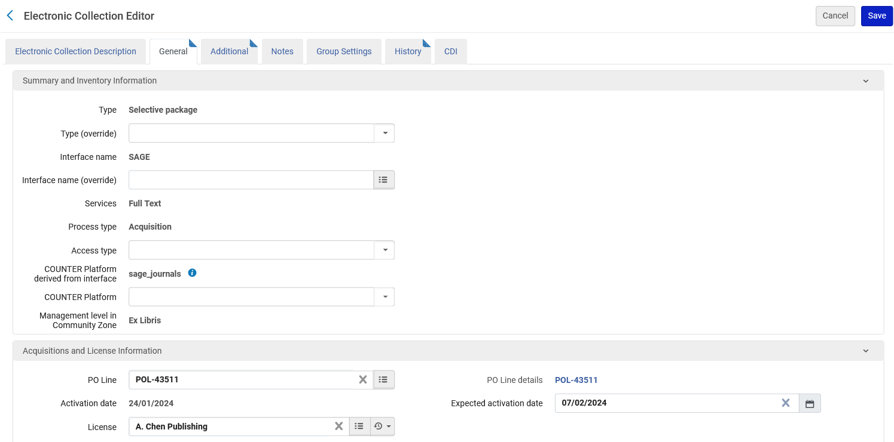
Associating a license to an electronic resource
The electronic collection inherits the license from the POL

Slide 40
Displaying the license information in discovery

Slide 41
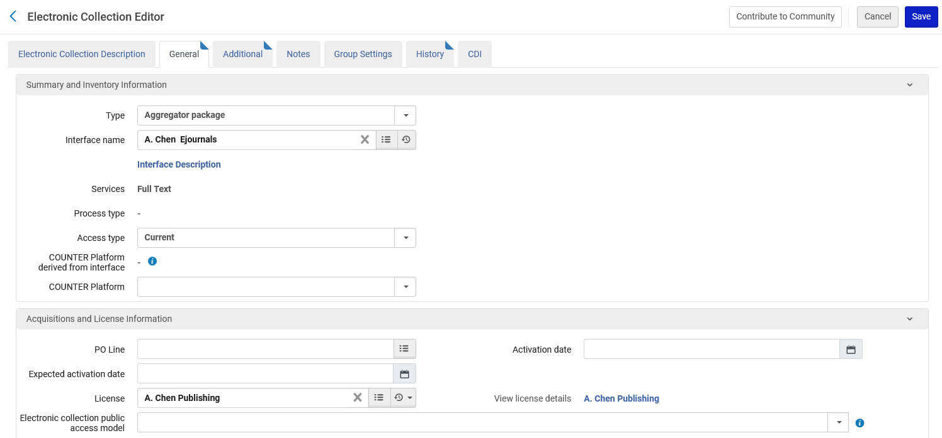
Displaying the license information in discovery
As we already saw, the electronic collection “Resources about libraries in Taiwan” has the license “A. Chen Publishing”

Slide 42
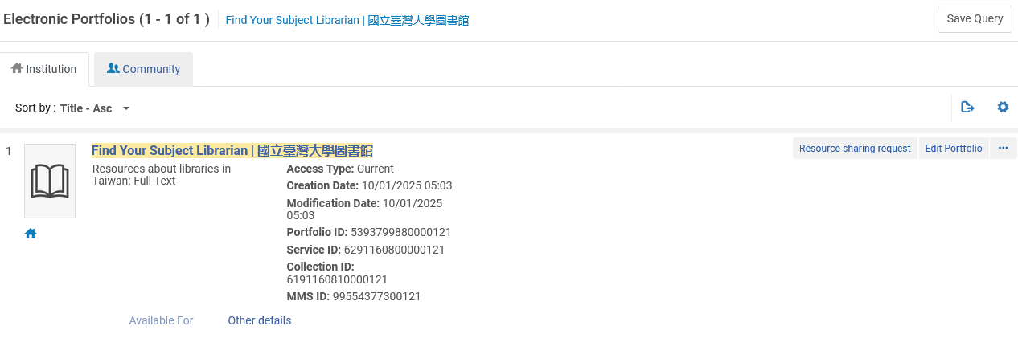
Displaying the license information in discovery
One of the portfolios in electronic collection “Resources about libraries in Taiwan” is “Find Your Subject Librarian | 國立臺灣大學圖書館”

Slide 43
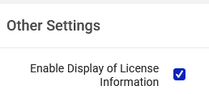
Displaying the license information in discovery
If we want the user in discovery to see license information when he or she accesses “Find Your Subject Librarian | 國立臺灣大學圖書館” then we need to check “Enable Display of License Information” at “Configuration > Fulfillment > Discovery Interface Display Logic > Other settings”.
See also How to make license information appear in Primo View It (View Online) after clicking Available Online

Slide 44

Displaying the license information in discovery
A user has found the record in discovery and will click “Available Online”

Slide 45
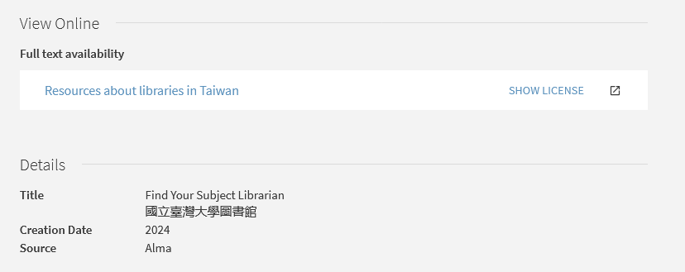
Displaying the license information in discovery
The user has a link to view the license

Slide 46
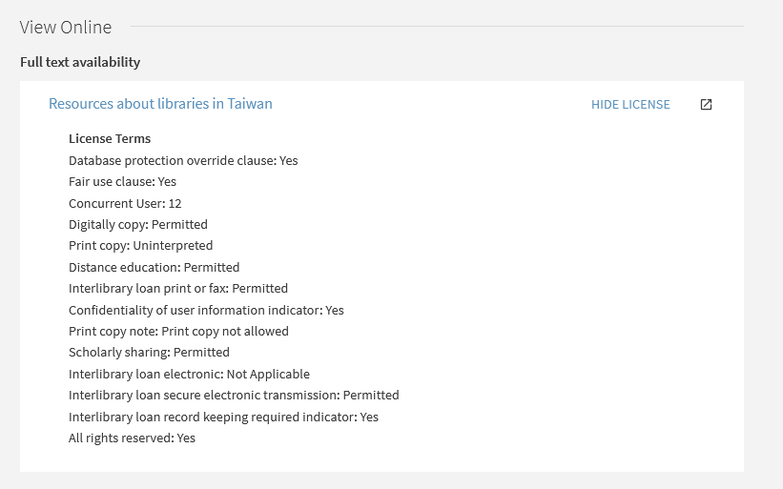
Displaying the license information in discovery
After clicking the link, the user views the license
Note that it is possible to configure which terms from the license will appear here at “Configuration > Acquisitions > Licenses > Manage License Terms”

